Slide 1
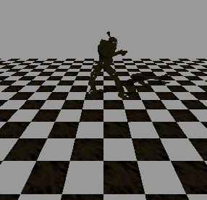
Planar Stencil Shadow

Slide 2
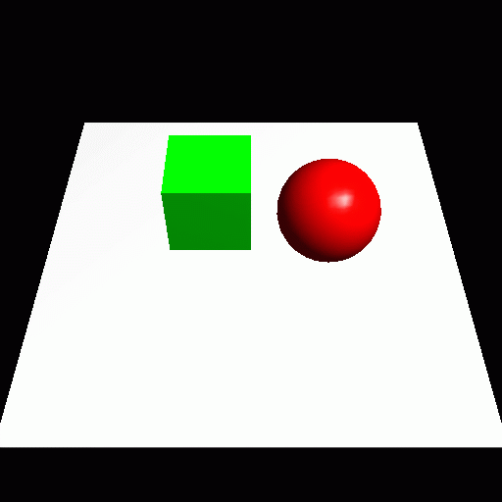
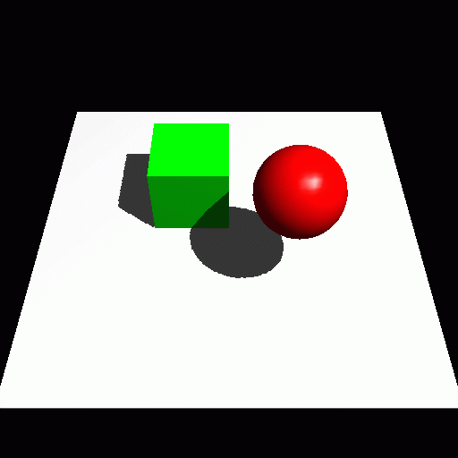
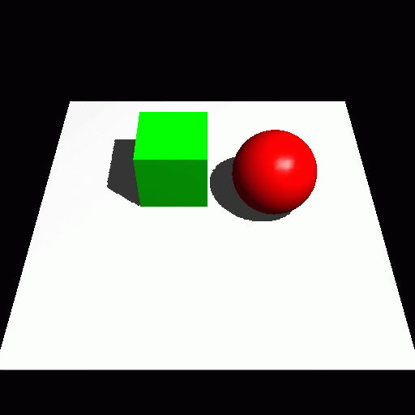
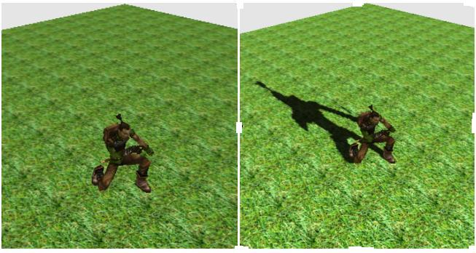
Shadows are important …
It is usually better to have an inaccurate shadow than none at all

Slide 3
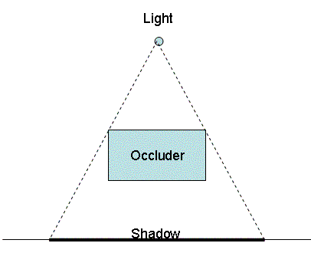
Terminology
(area) light source
occluder
penumbra
umbra
receiver
shadow
Hard Shadow
Soft Shadow

Slide 4
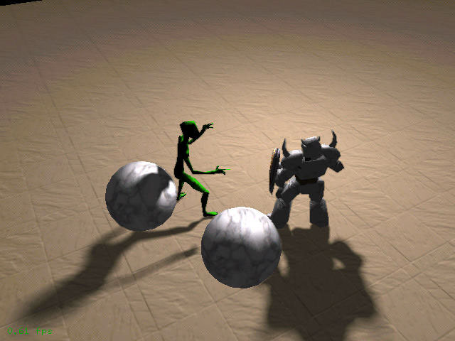
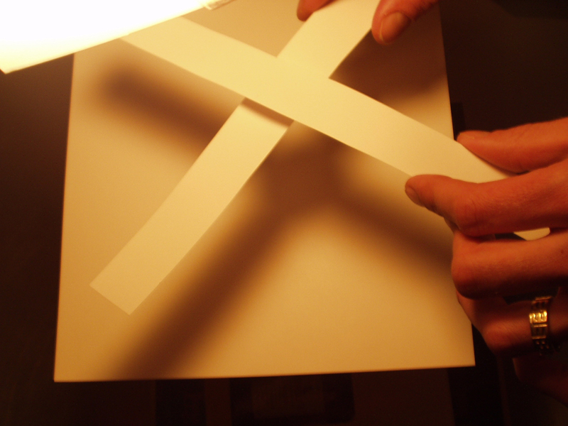
Soft Shadows (Ref)
  Point light generates hard shadows only
  Soft shadows are NOT generated by low pass filters
  Soft shadows are generally preferable, if possible.

Slide 5
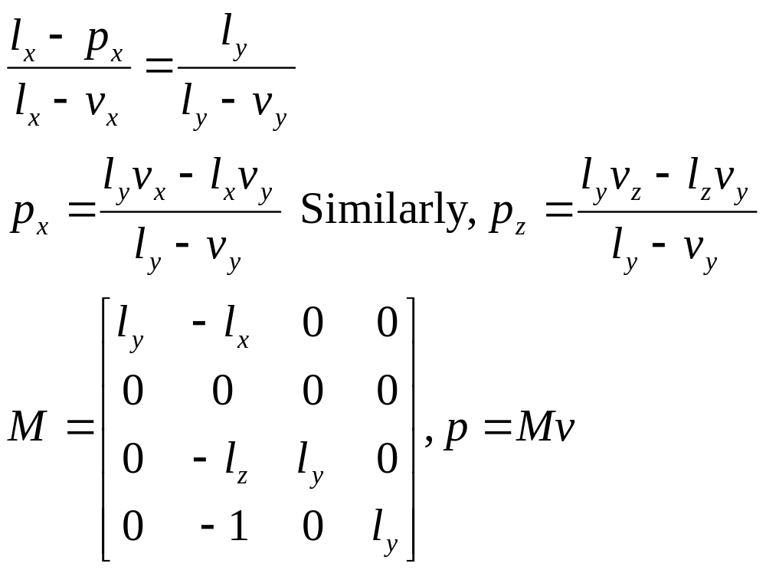
Planar Projection Shadow (xz plane)
l
y
v: any pt on
model
v
shadow
x
p

Slide 6
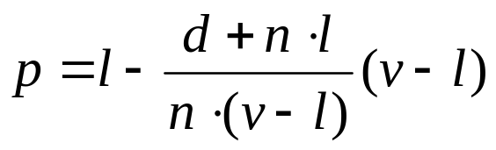
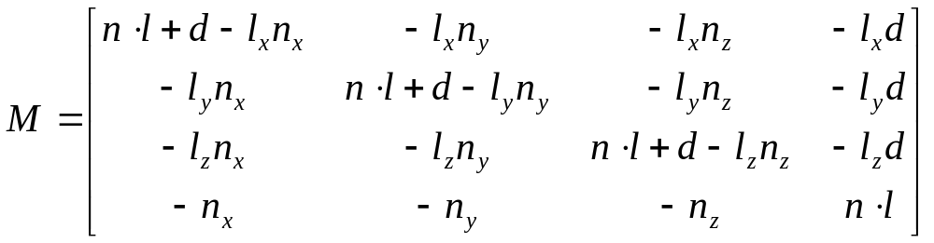
Planar Projection (general)
l
v
n
p
π:n•x+d=0

Slide 7
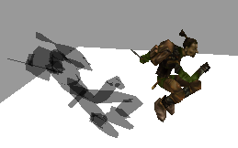
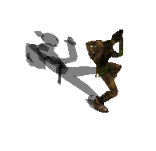
Planar Projection Shadow
Problems [& Solutions]
  Z-fighting [polygon offset, stencil]
  Shadow fall outside of the receiver [stencil]
  Semi-transparent shadows [blending + stencil, ensuring each pixel is drawn at most once]
  Planar receiver only
  Need to render each frame (But for static objects, the shadows are view-independent) [render the shadow into texture]

Slide 8
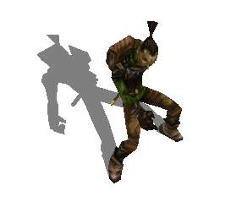
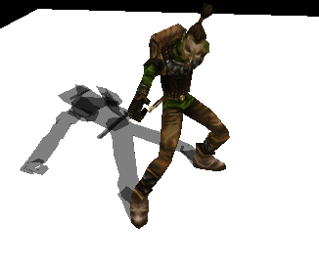
Remark
Shadow polygons are blended with the floor, one-by-one
Repetitive blending …
To prevent this from happening, use stencil buffer
When a polygon is drawn, increment the stencil count (therefore, the area is not drawn again)
glStencilFunc(GL_EQUAL, 1, 0xFF);
glStencilOp (GL_KEEP, GL_KEEP, GL_INCR);

Slide 9
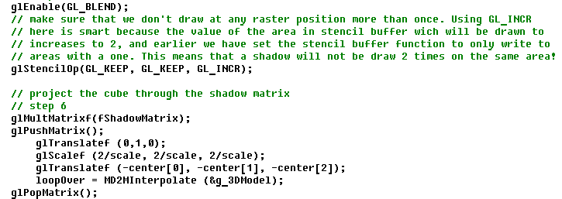
Stencil Setting

